Slide 1
Title of Selected Challenge
Agri-Tech Hackathon 2022
Bahir Dar Institute of Technology
April 2022

Slide 2
Outline
Introduction
Motivation
Objectives
System diagram
Required materials
Time schedule for work
Challenges (if any)
Summary
Group members

Slide 3
Introduction

Slide 4
Motivation
Motivation of the project

Slide 5
Objectives

Slide 6


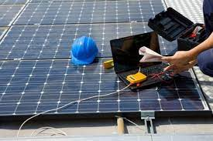

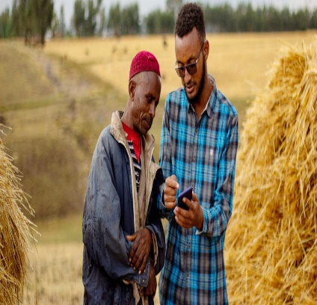
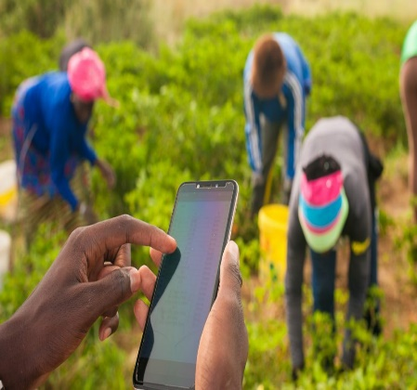
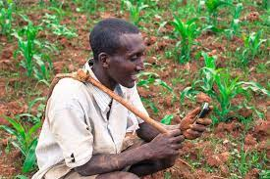

Slide 7
System diagram
Proposed system diagram

Slide 8
Required materials for the project

Slide 9
Time schedule of the project

Slide 10
Group Members

Slide 11
Thank you

